Slide 1
RoomNet – a ConvNet to classify real-estate pictures
Souham Biswas

Slide 2
Classification Labels / Quick results
Following are the class labels with their numeric IDs used to build this neural net –
Backyard – 0
Bathroom – 1
Bedroom – 2
Frontyard – 3
Kitchen – 4
LivingRoom – 5
Achieved Validation Accuracy of 88.9% over 1839 validation images.

Slide 3
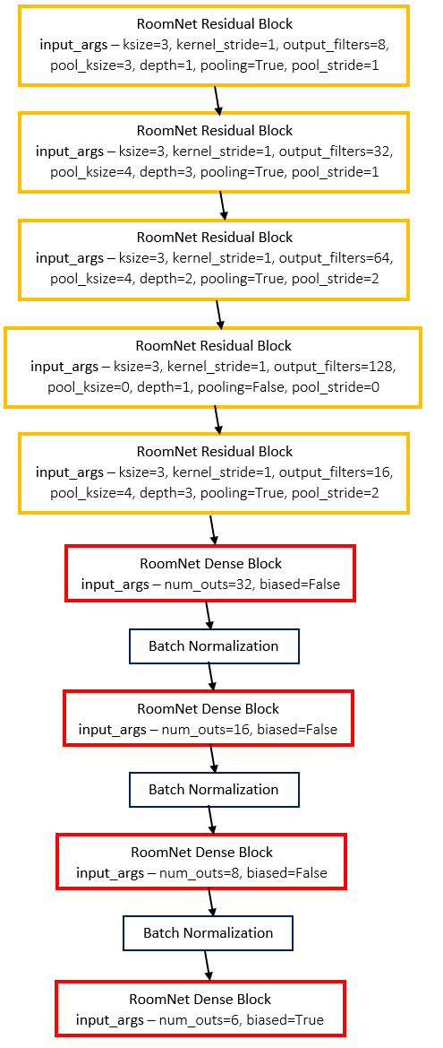
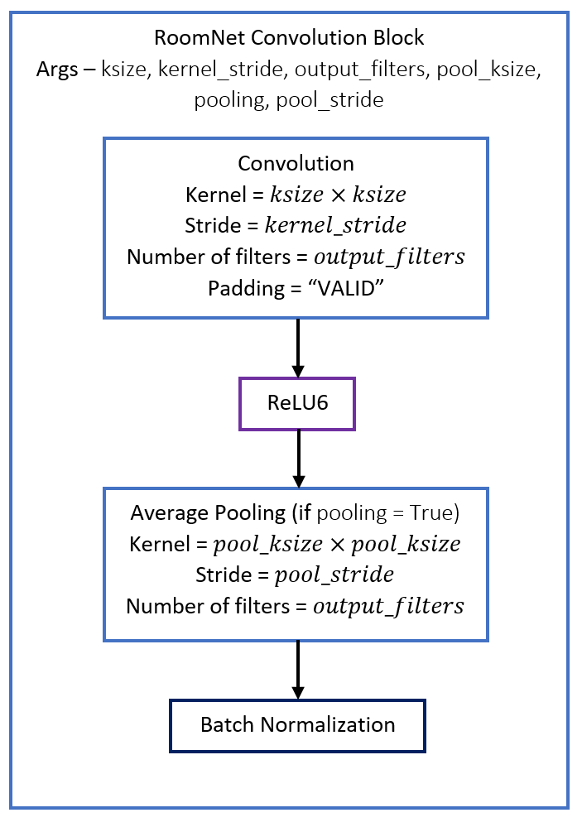
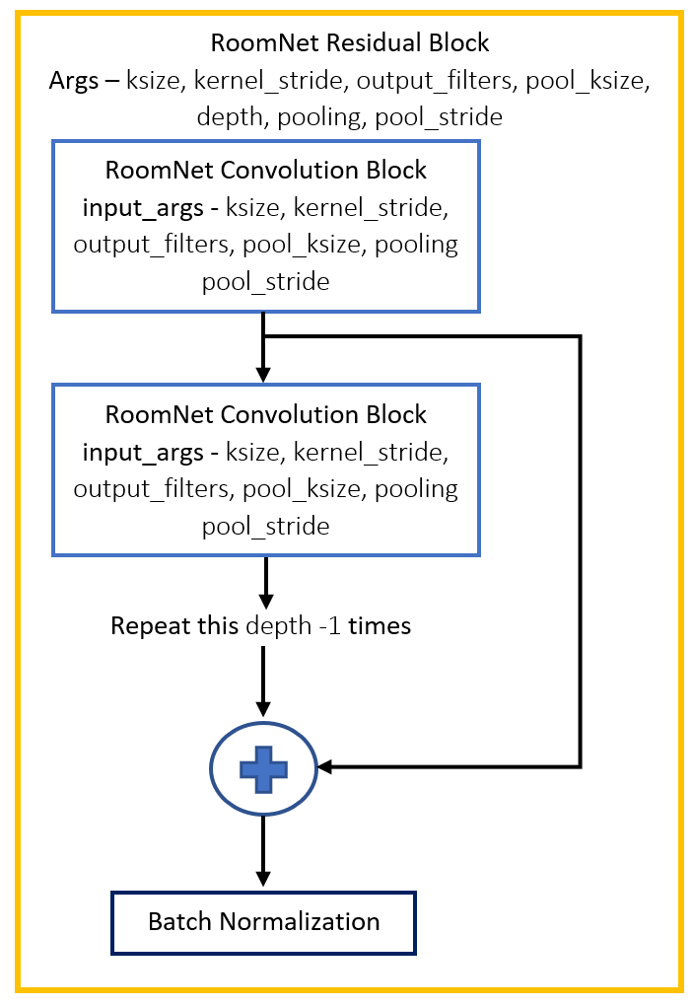
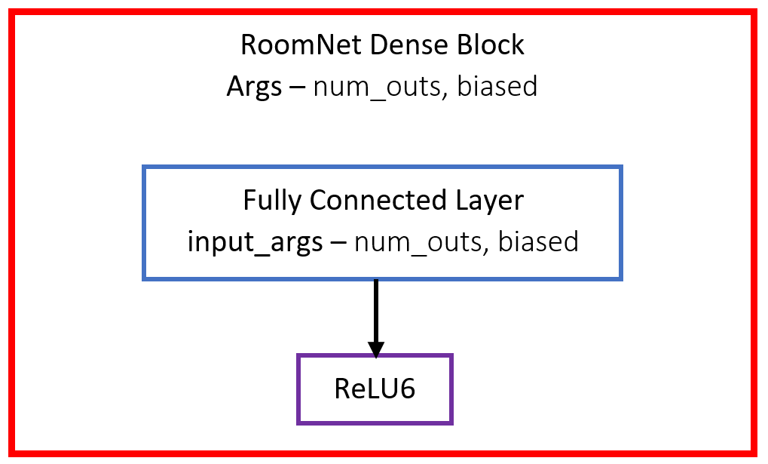
RoomNet Architecture

Slide 4
Training Process
Input image size = 224 x 224 (tried 300 x 300, 600 x 600)
Softmax Cross Entropy Loss used with L2 Weight normalization
Dropout varied from 0 (initially) to 0.3 (intermittently near the end of training). Dropout layers placed after every block.
Batch Normalization moving means & vars were frozen when being trained with dropout
Adam Optimizer used with exponential learning rate decay.
Initially trained with in-batch computation of BatchNorm moving means/vars. Followed this by training net, by disabling this computation and using frozen means/vars during training. Resulted in 10% immediate jump in validation accuracy.
Batch Size varied from 8 (in the beginning) to 45 (towards training end) as – 8 -> 32 -> 40 -> 45
Asynchronous Data Reader designed with a Queue based architecture which allows for quick data I/O during training even with large batch sizes.

Slide 5
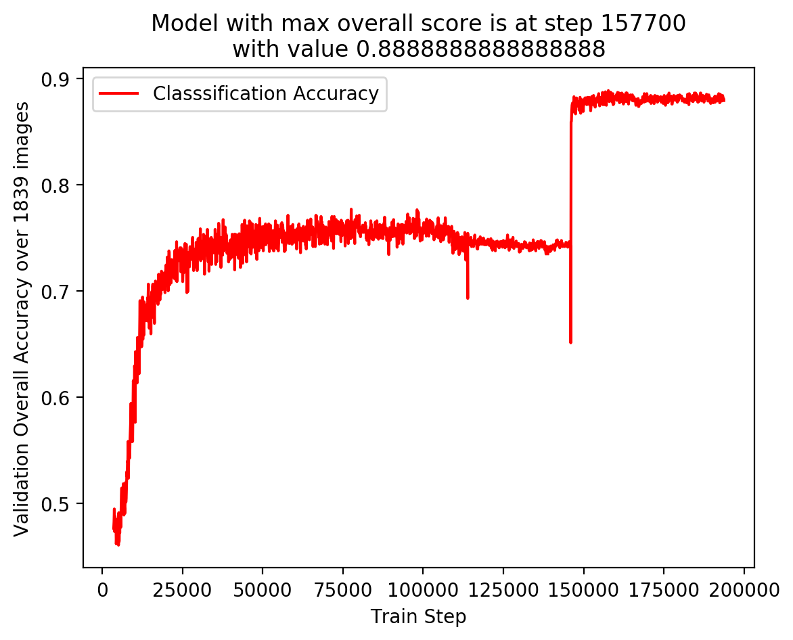
Validation Accuracy plot

Slide 6
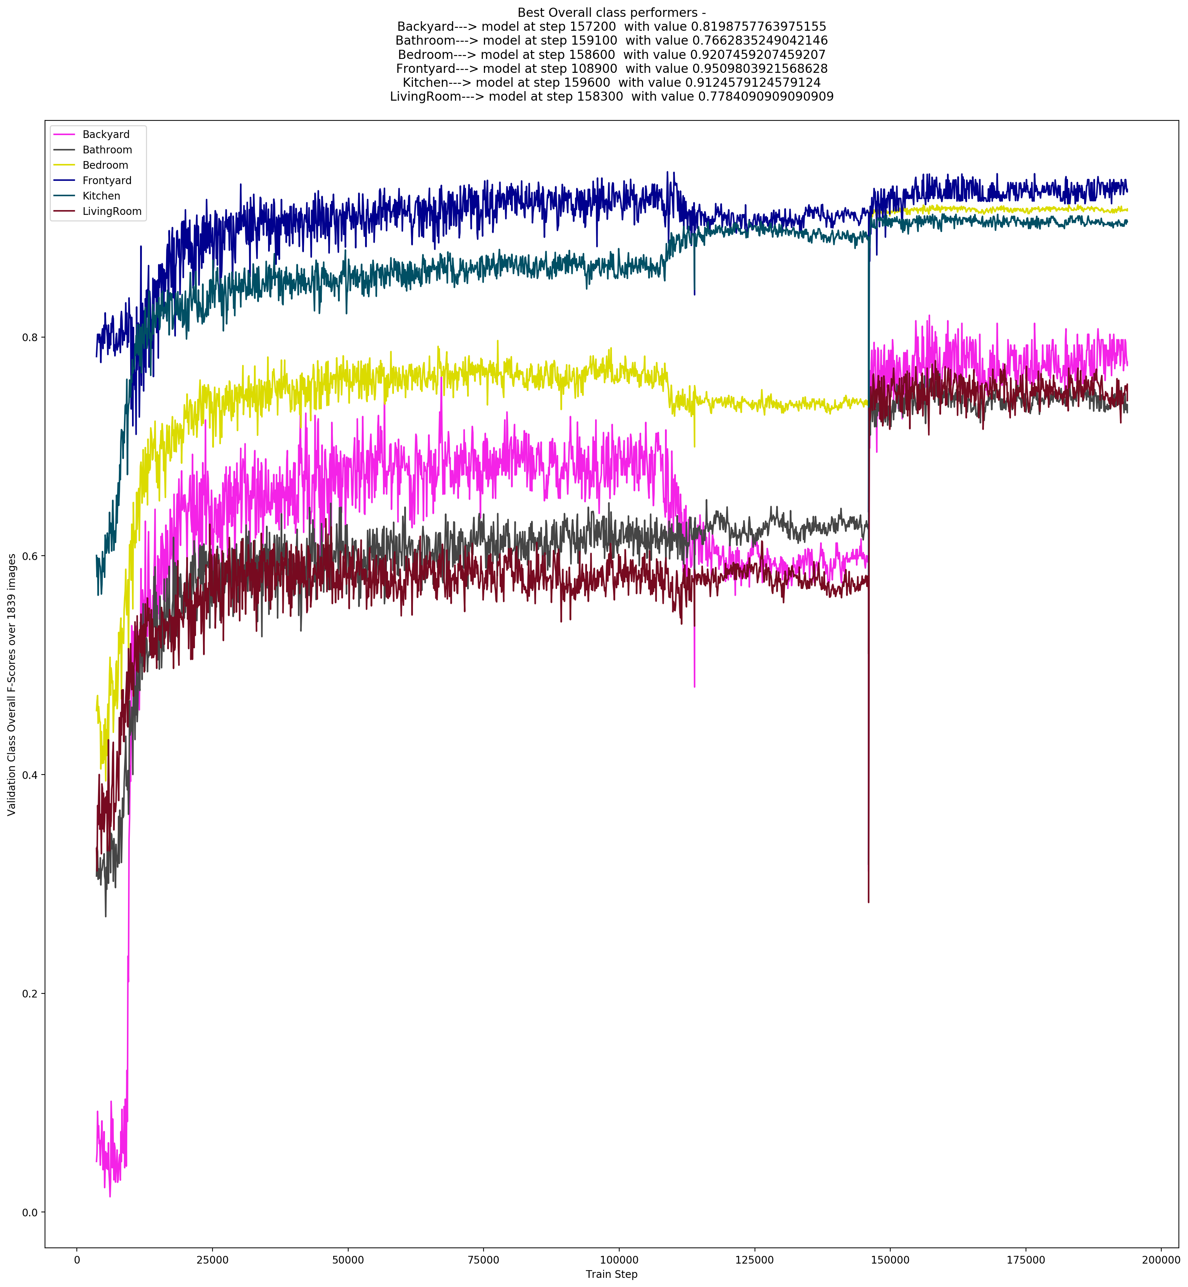
Class-wise Validation F-Score Plot

Slide 7
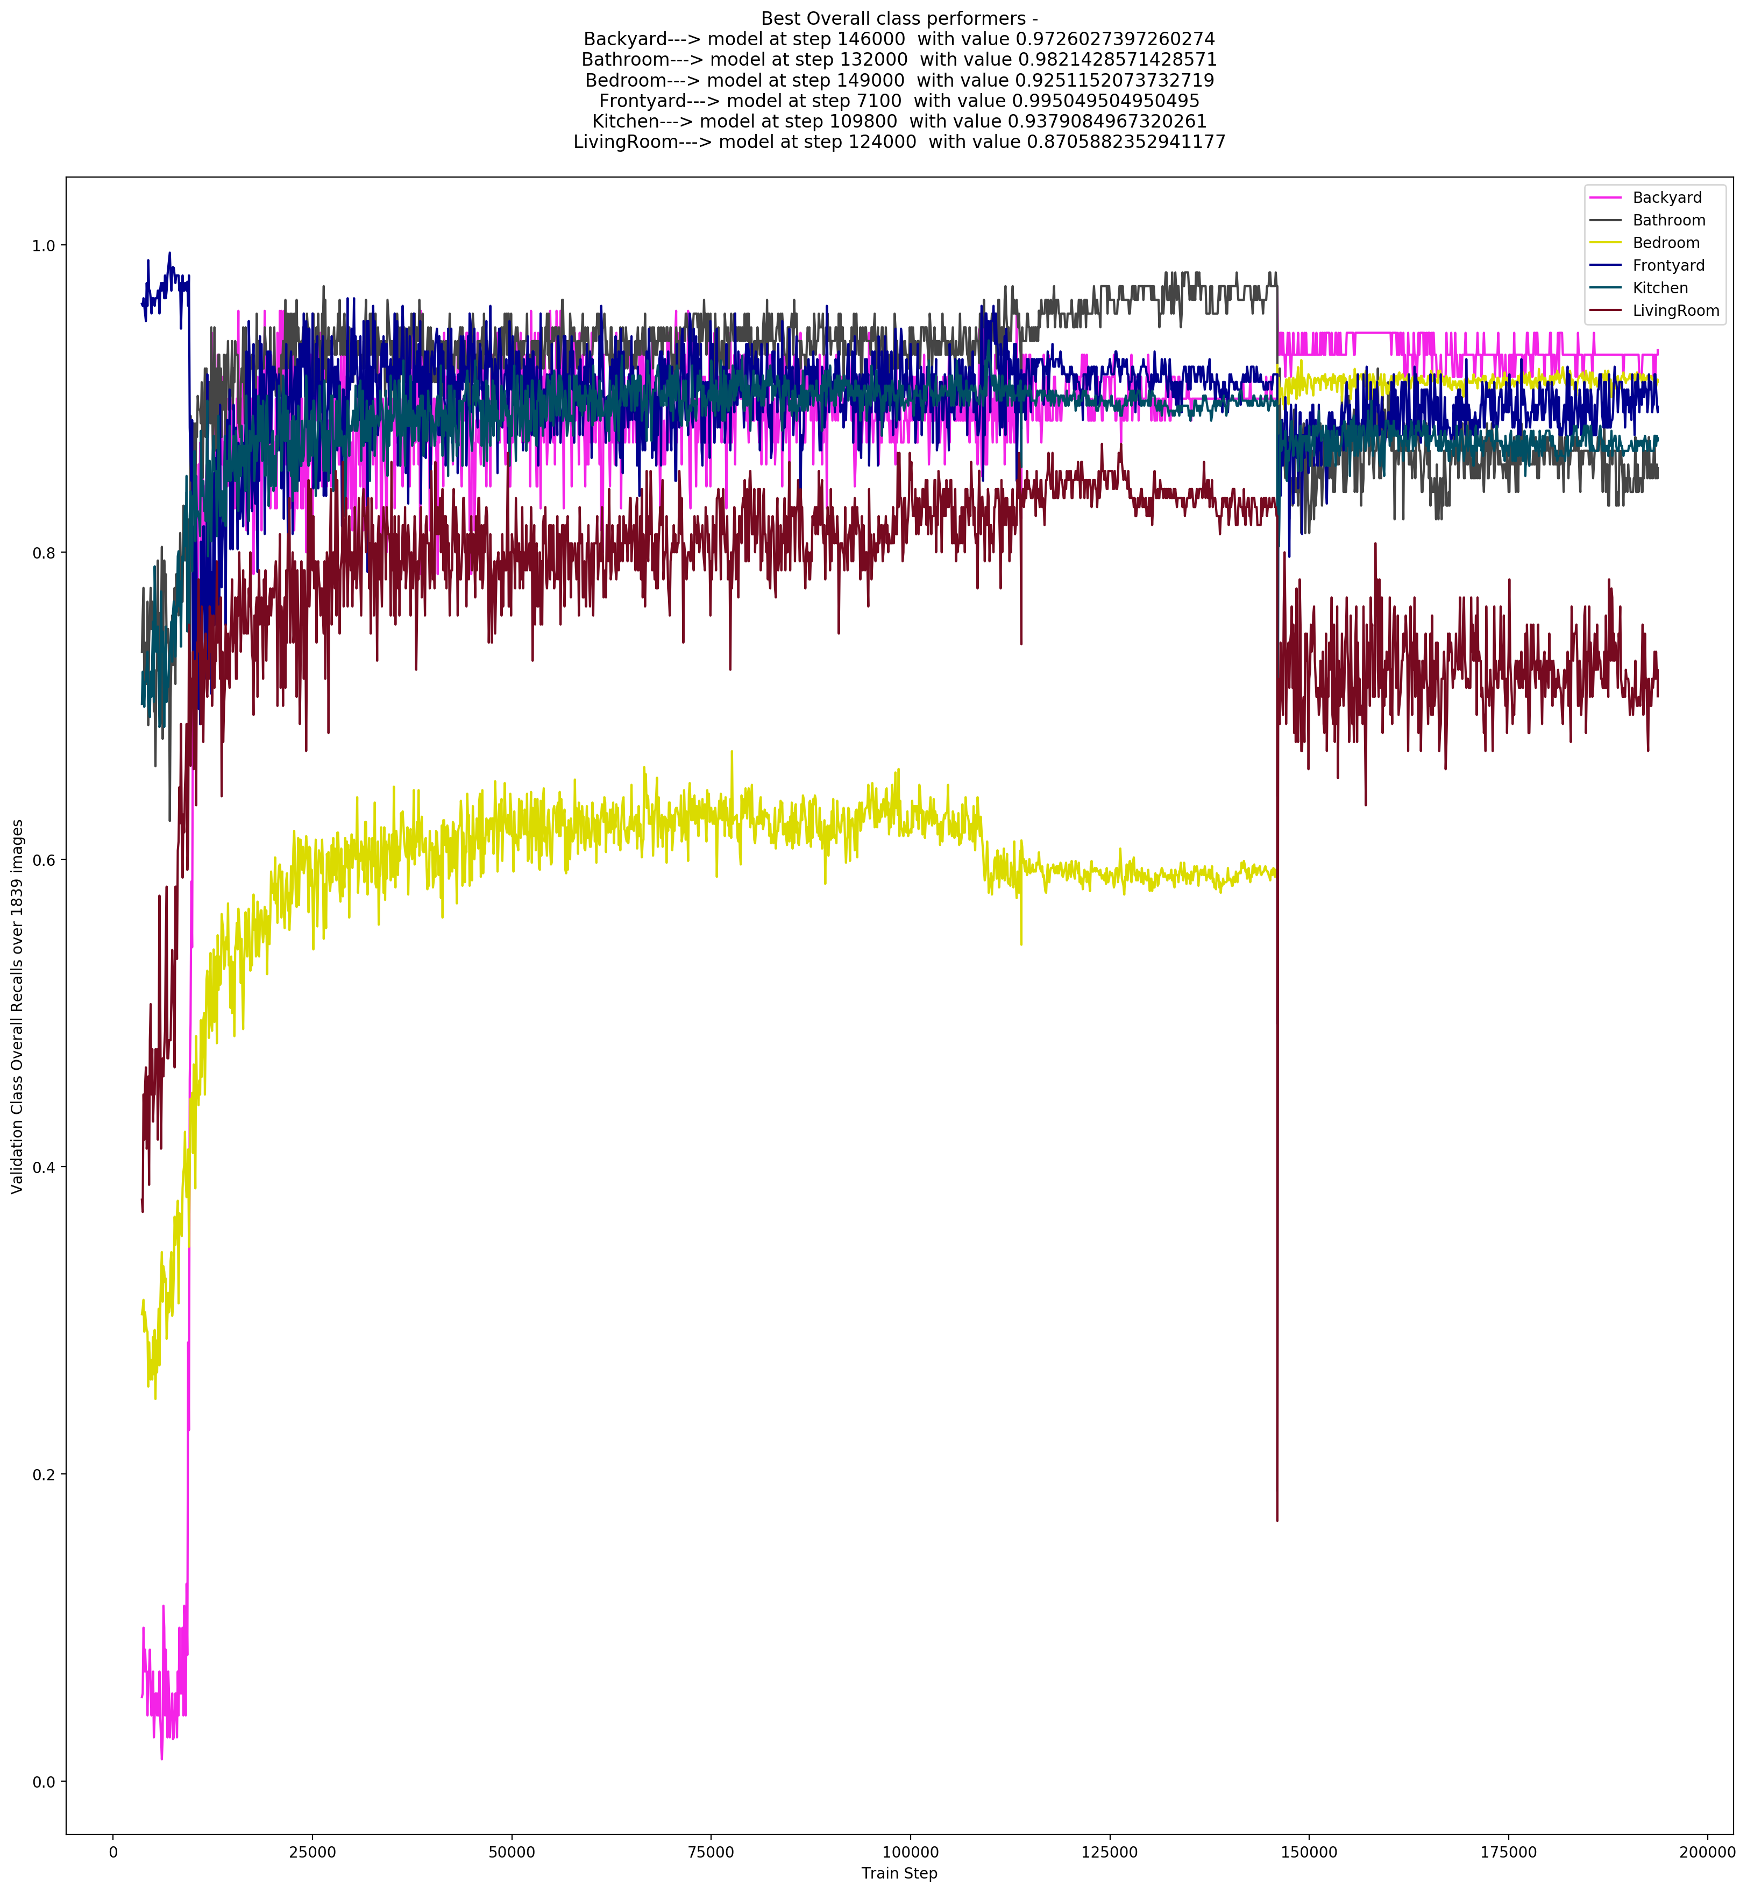
Class-wise Validation Recall Plot

Slide 8
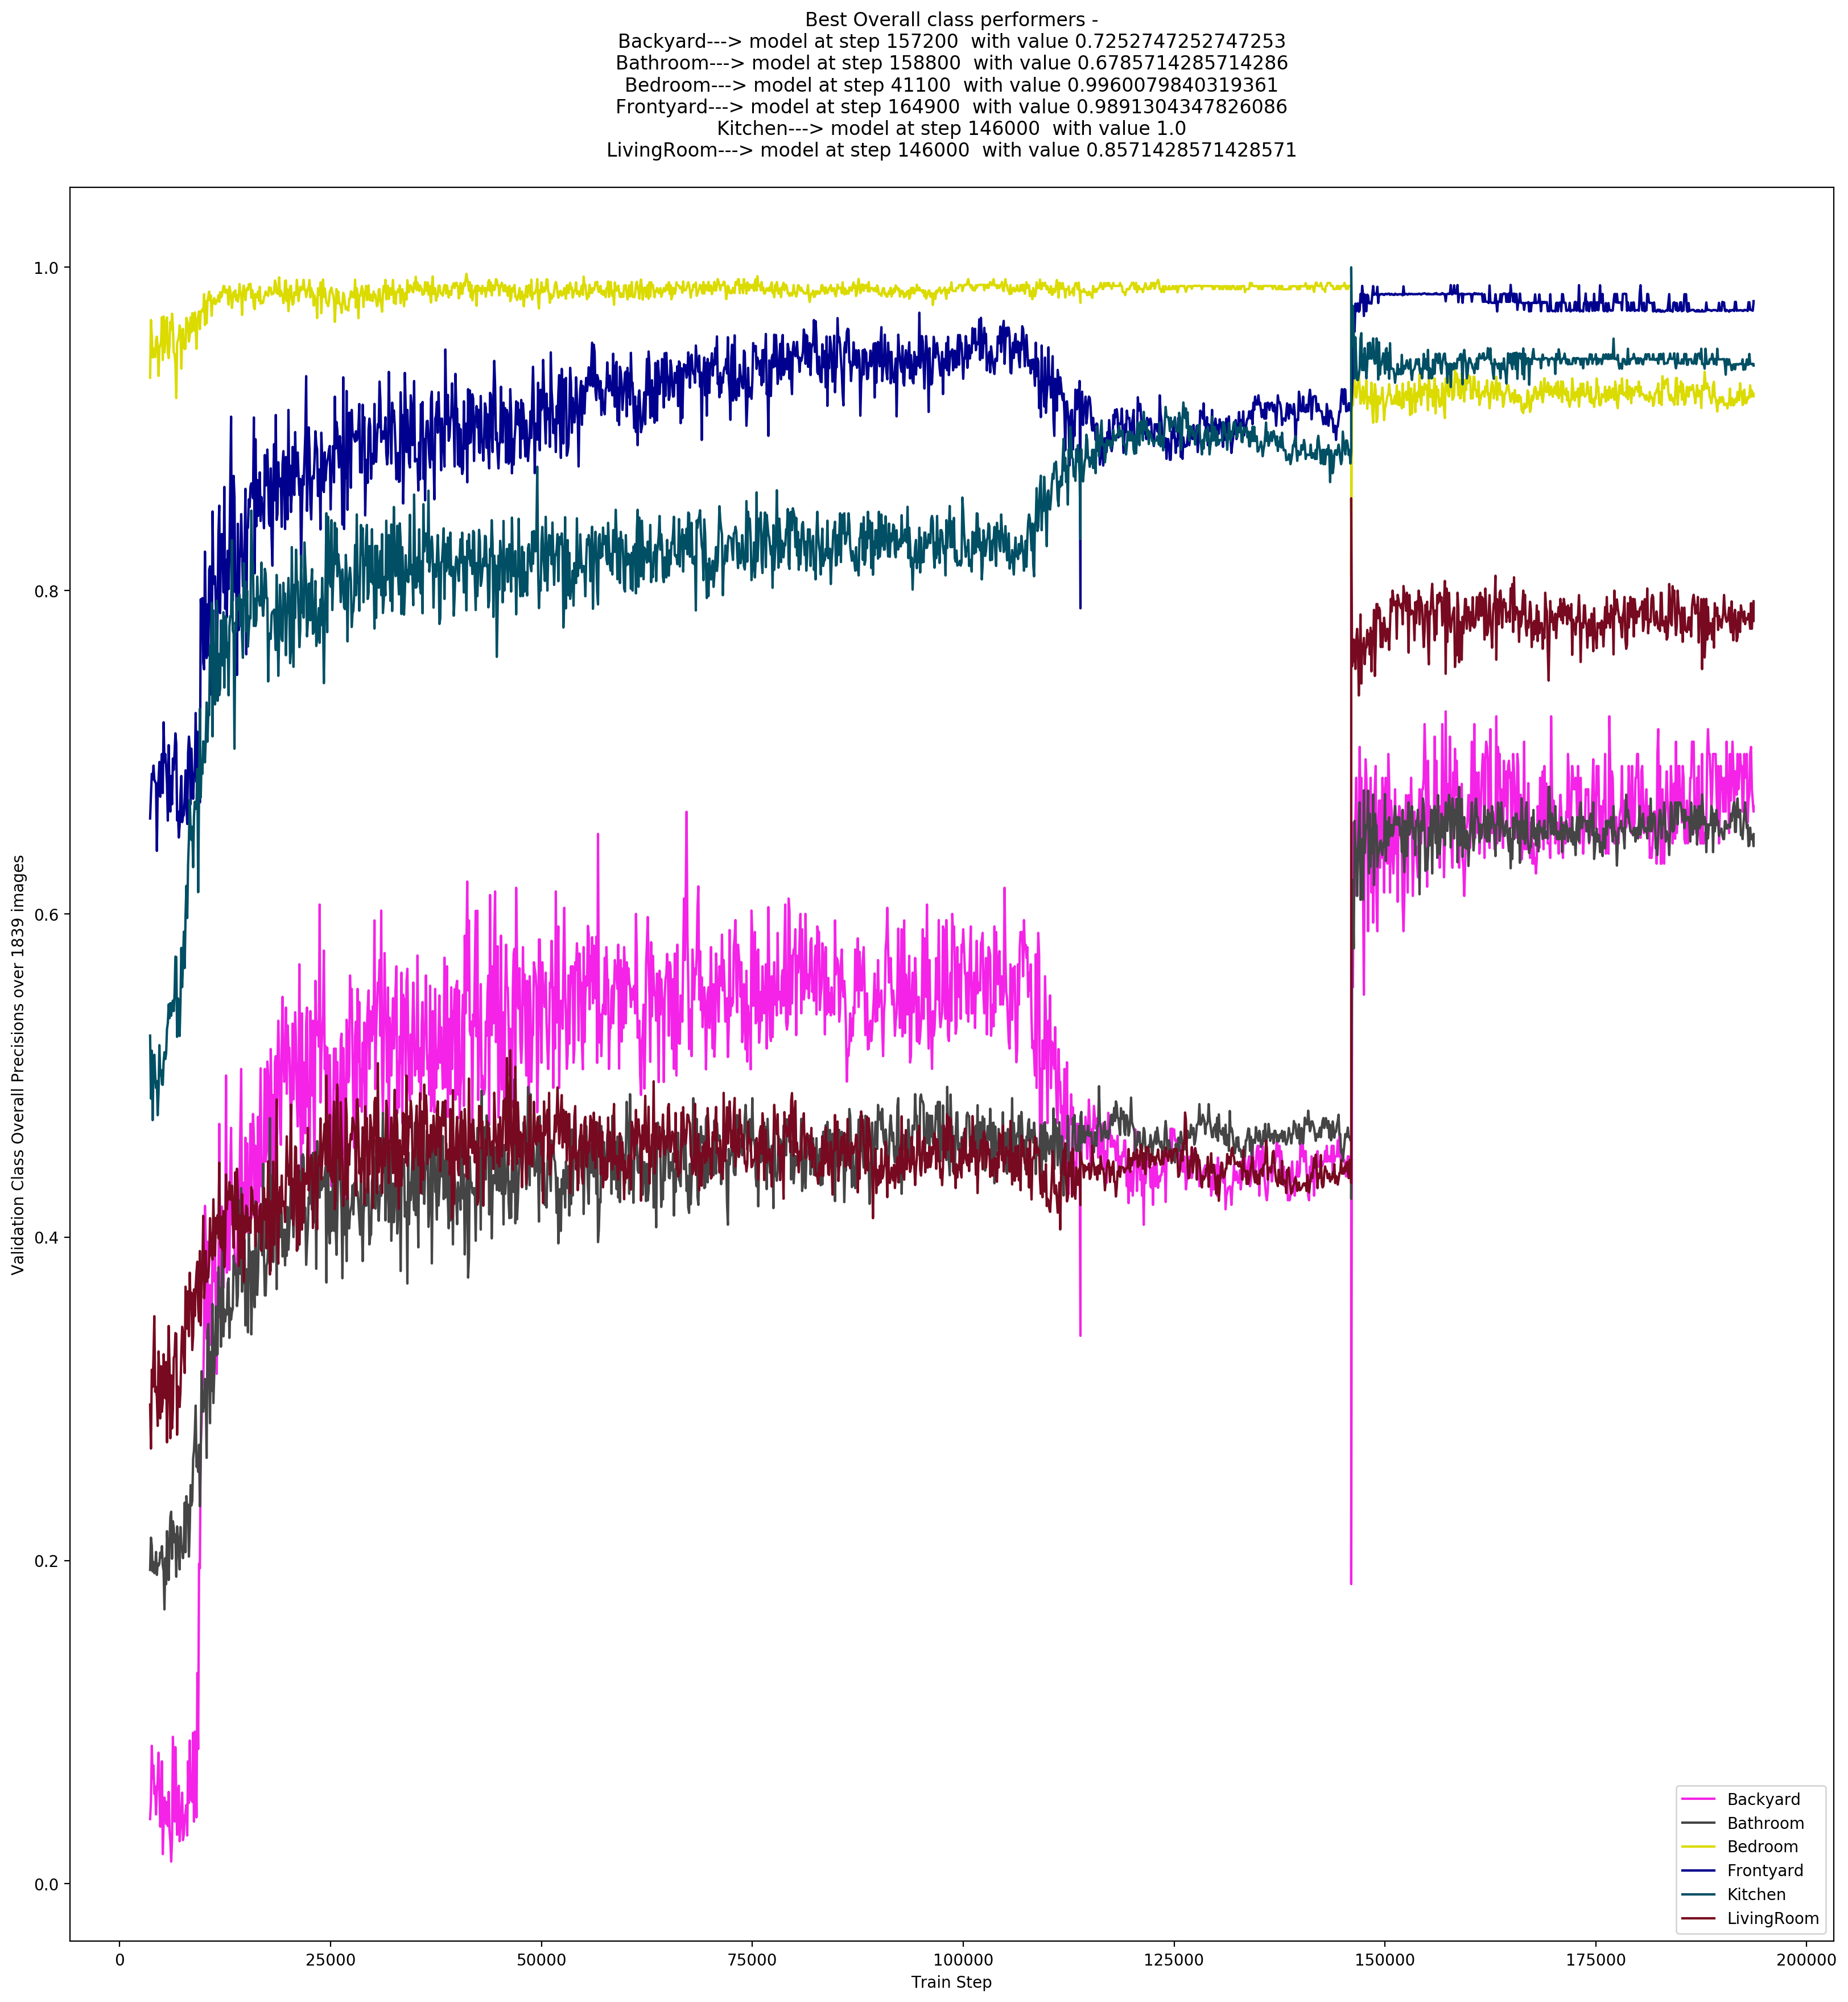
Class-wise Validation Precision Plot

Slide 9
Conversion to Inference optimized model
Discarded all back propagation/training related compute node from the Tensorflow Graph.
Model size reduced from ~2 MB to ~800 KB.
Supports batched inference and streaming inference.
network.py contains class defining the model called “RoomNet”
infer.py contains code using the model class to do black-box inference.
Output is an excel file mapping each image path to its label. There is also provision to split an input directory to directories corresponding to the class names and automatically fill the relevant image in its respective directory.

Slide 10
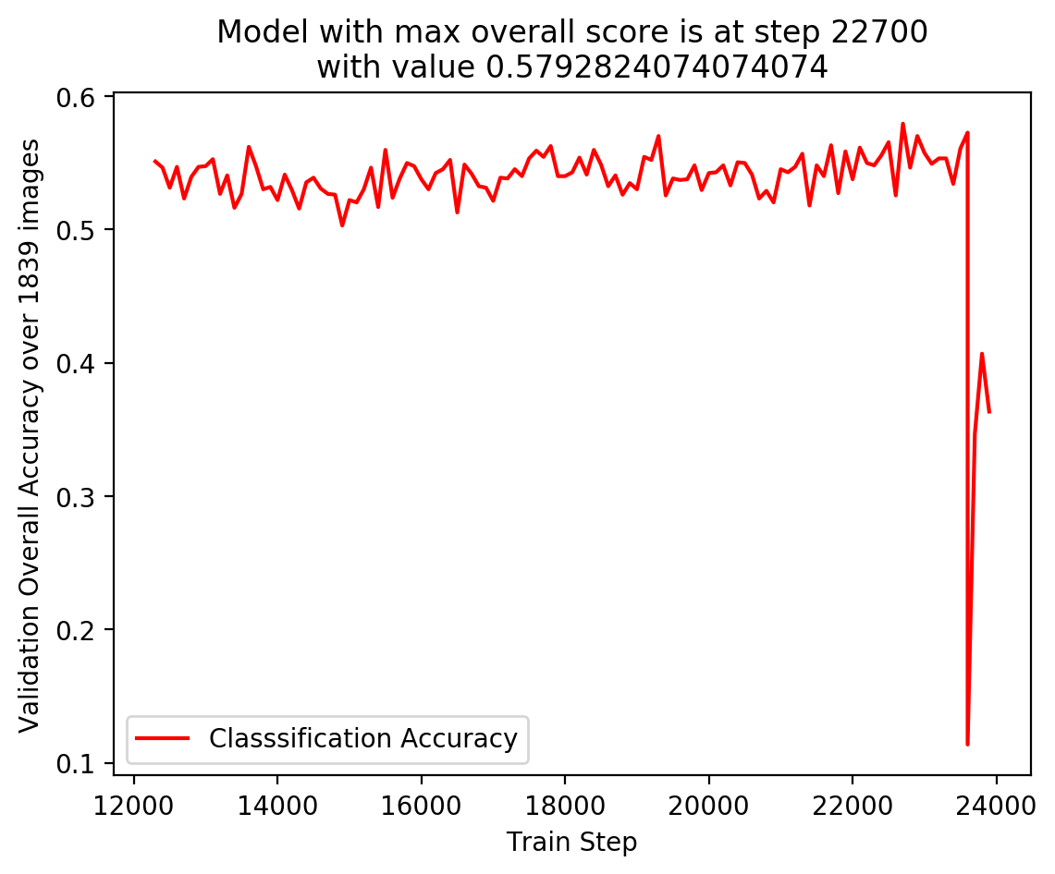
Previous Approaches tried – NASnet Mobile
Trained final layers of NASnet Mobile (Neural Architecture Search by Google) to work on this dataset, but got the following result –
Accuracy never crosses 60% (best is 57.9%) and model overfits/diverges towards the end.
Similar results obtained while using InceptionV3 as base network.

Slide 11
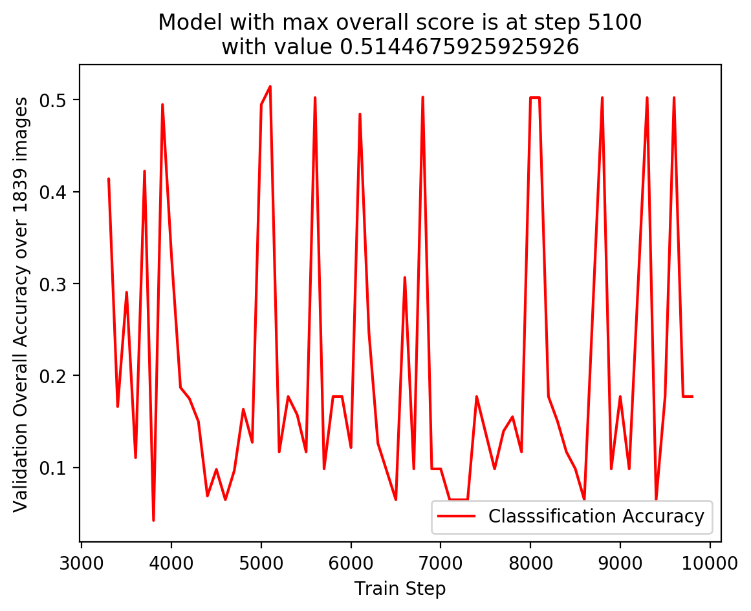
Previous Approaches tried – Custom architecture 1
Trained a lightweight custom architecture with no residual blocks or frozen batch-norm. Following the validation accuracy plot–
Accuracy never crosses 52% (best is 51.45%) and model overfits/diverges towards the end.
Model turned out a bit too “lightweight” for the problem.

Slide 12
Training Environment & Time
Training done using Tensorlfow + CUDA 10.0 + cuDNN on NVIDIA GTX 1070 laptop grade GPU with 8GB of GPU memory
Compute system used is an Alienware m17 r4.
CPU used is an Intel Core i7 – 6700HQ with 8 logical cores at 2.6 GHz of base speed (turbo boost to ~3.3 GHz)
Number of training steps from scratch to reach best model is 157,700.
Time spent on training - ~48 hours

Slide 13
Thank you ☺

